Slide 1
Topics to be covered
Exploratory Data Analysis:
  Scatter plots, histograms, correlogram analysis
  Outlier Detections
  Hierarchical inference
Machine Learning Techniques:
  Regression Techniques:
    Linear Regression
    Logistic Regression
    Lasso Regression (cost based)
Machine Learning Techniques for Classification:
  k-Nearest Neighbor, Support Vector Machine (SVM), Decision Tree, Random Forrest

Slide 2
Exploratory Data Analysis
Given a data set always perform exploratory data analysis to get a rough idea about the data you are about to handle.
In a data set the columns with the corresponding column headers are called the features of the data.
Exploratory analysis should produce deeper insight about the data in the following ways:
  Pictorial representation of relationship between different features (scatter plot)
  Histograms should produce the distribution on the values of different features
  Correlogram analysis should produce the quantitative relationship between the features.
  One should always detect outliers from the data before doing deeper analysis
  Exploratory analysis will also help you to build hierarchical inferences about the data

Slide 3

Example 1: Health Data
Create a folder in Desktop with the name DataSet
Click on the following dataset and save it with the name HeightWeight.xlsx in the folder DataSet
Snapshot of the dataset:
GENDER is 1 = Male and 2 = Female
AGE is in years.
WEIGHT is in Pounds.
HEIGHT is in Inches.
MORE_THAN_SIXFOOT is 1 if the height is more than six foot and 0 otherwise.
LEG_LENGTH is in inches.
WAIST_CIRCUMFERNCE is in inches.
THIGH_CIRCUMFERENCE is in inches.
BMI OVER 30 is 1 if BMI is over 30 and 0 otherwise.

Slide 4
Example 1 (Exploratory Analysis)
How many males are there in the dataset ?
How many females are there in the dataset ?
How is the histogram of height for males and females separately.
Code:
import os # Importing library for operating system
import numpy as np # Importing library to handle number arrays
import pandas as pd # Importing library to handle data frames
import matplotlib.pyplot as plt # Importing library for plotting
## Reading Data
data = pd.read_excel("HeightWeight.xlsx")
data = data.dropna()
## Finding the frequency of males and females
frequency = data['GENDER'].value_counts()
frequency
Output:
This means the dataset has 59 females and 40 males
2 59
1 40

Slide 5
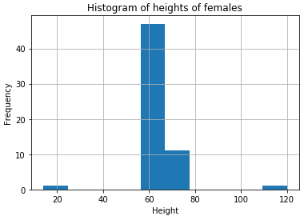
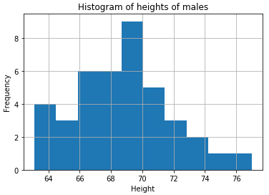
Example 1 (Continued)
How is the histogram of height for males and females separately.
## Slicing the data for only males
data_male = data[data['GENDER']==1]
## Making histogram for males
plt.hist(data_male['HEIGHT'])
plt.title("Histogram of heights of males")
plt.xlabel("Height")
plt.ylabel("Frequency")
plt.grid()
plt.show()
## Slicing the data for only males
data_female = data[data['GENDER']==2]
## Making histogram for males
plt.hist(data_female['HEIGHT'])
plt.title("Histogram of heights of females")
plt.xlabel("Height")
plt.ylabel("Frequency")
plt.grid()
plt.show()
Inferences
The distribution of height of males is as par expectation
But the distribution of heights of females seem to contain outliers: 20 inches and 110 inches
Hence delete those two data points and replot the histogram.

Slide 6
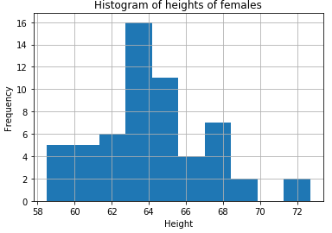
Example 1 (Continued)
How is the histogram of females after deleting the outliers ?
data_females_outliersdeleted = data_female[data_female['HEIGHT'] <90]
data_females_outliersdeleted = data_females_outliersdeleted[data_females_outliersdeleted['HEIGHT'] >40]
plt.hist(data_females_outliersdeleted['HEIGHT'])
plt.title("Histogram of heights of females")
plt.xlabel("Height")
plt.ylabel("Frequency")
plt.grid()
plt.show()

Slide 7
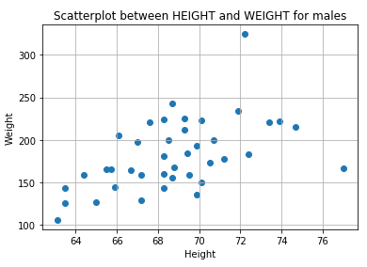
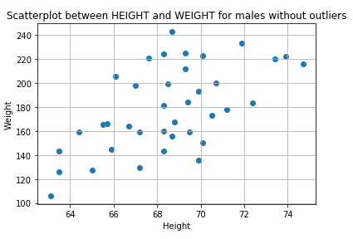
Example 1 (Continued)
How is the scatterplot and correlation between HEIGHT and WEIGHT for males ?
print (np.corrcoef(data_male['HEIGHT'],data_male['WEIGHT'])[0][1])
plt.scatter(data_male['HEIGHT'], data_male['WEIGHT'])
plt.title("Scatterplot between HEIGHT and WEIGHT for males")
plt.xlabel("Height")
plt.ylabel("Weight")
plt.grid()
plt.show()
Correlation = 0.5156
data_male_deletedOutliers = data_male[data_male['HEIGHT'] < 76]
data_male_deletedOutliers = data_male_deletedOutliers[data_male_deletedOutliers['WEIGHT']<300]
print (np.corrcoef(data_male_deletedOutliers['HEIGHT'],data_male_deletedOutliers['WEIGHT'])[0][1])
plt.scatter(data_male_deletedOutliers['HEIGHT'], data_male_deletedOutliers['WEIGHT'])
plt.title("Scatterplot between HEIGHT and WEIGHT for males without outliers")
plt.xlabel("Height")
plt.ylabel("Weight")
plt.grid()
plt.show()
Correlation = 0.5972

Slide 8
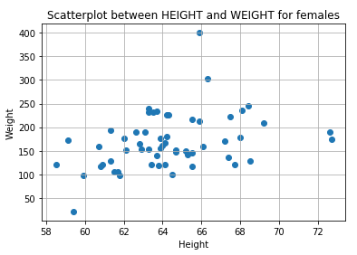
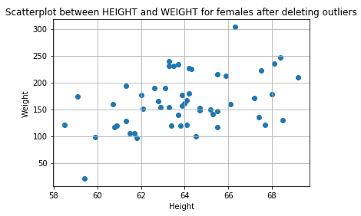
Example 1 (Continued)
How is the scatterplot and correlation between HEIGHT and WEIGHT for females ? Take the data that is already cleaned up.
print (np.corrcoef(data_females_outliersdeleted['HEIGHT'],data_females_outliersdeleted['WEIGHT'])[0][1])
plt.scatter(data_females_outliersdeleted['HEIGHT'], data_females_outliersdeleted['WEIGHT'])
plt.title("Scatterplot between HEIGHT and WEIGHT for females")
plt.xlabel("Height")
plt.ylabel("Weight")
plt.grid()
plt.show()
data_females_outliersdeleted = data_females_outliersdeleted[data_females_outliersdeleted['HEIGHT'] <70]
data_females_outliersdeleted = data_females_outliersdeleted[data_females_outliersdeleted['WEIGHT'] <350]
print (np.corrcoef(data_females_outliersdeleted['HEIGHT'],data_females_outliersdeleted['WEIGHT'])[0][1])
plt.scatter(data_females_outliersdeleted['HEIGHT'], data_females_outliersdeleted['WEIGHT'])
plt.title("Scatterplot between HEIGHT and WEIGHT for females")
plt.xlabel("Height")
plt.ylabel("Weight")
plt.grid()
plt.show()
Correlation = 0.3611
Correlation = 0.4121

Slide 9
Summary
Detect outliers if present in the data.
Plot histograms, scatterplots to understand the distribution of features.
Keep on making hierarchical inferences as you make such plots of the data.
Clean up the data before starting to do any deeper analysis.

Slide 10
Machine Learning Techniques
Part I : Basic Regression Techniques

Slide 11
Why do we need Regression ?
Regressions are used to predicting values of a certain outcome variable using the input variables.
Regressions also help to understand the impact of each of the input variables on the outcome variable.
Regressions also help us to take corrective actions to prevent some future outcomes.
For example, in the context of this problem we can ask can we predict weight using the height of individuals ? (e.g. the input variable is HEIGHT and the outcome variable is WEIGHT)

Slide 12
Simple Linear Regression
Can we use HEIGHT to predict the WEIGHT of males ?
Model:
Weight of an individual = α + β x height of the individual
Methodology for fitting a model:
First divide the entire labelled data into 2 parts (1) Training data (2) Test data
On the training data we will train our model.
The trained model will then be tested on the test data.
We will judge the effectiveness of our trained model on correctness of the predictions on the test data using metrics such as (a) Root Mean Squared Error (RMSE)

Slide 13




Simple Linear Regression – Splitting the data
from sklearn import linear_model
from sklearn.metrics import mean_squared_error
## Creating training dataset
data_male_deletedOutliers_train_HEIGHT = data_male_deletedOutliers['HEIGHT'][:-10]
data_male_deletedOutliers_train_WEIGHT = data_male_deletedOutliers['WEIGHT'][:-10]
## Creating test dataset
data_male_deletedOutliers_test_HEIGHT = data_male_deletedOutliers['HEIGHT'][-10:]
data_male_deletedOutliers_test_WEIGHT = data_male_deletedOutliers['WEIGHT'][-10:]
print(data_male_deletedOutliers_train_HEIGHT)
Print(data_male_deletedOutliers_train_WEIGHT)
Training data
Test data
Height
Weight
Height
Weight

Slide 14
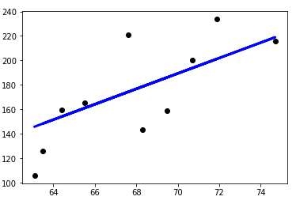
Simple Linear Regression – Fitting linear regression
## Create linear regression object
regr = linear_model.LinearRegression()
## Train the model using the training sets
regr.fit(data_male_deletedOutliers_train_HEIGHT.values.reshape(-1,1),data_male_deletedOutliers_train_WEIGHT.values.reshape(-1,1))
## Make predictions using the testing set
data_males_WEIGHT_predicted = regr.predict(data_male_deletedOutliers_test_HEIGHT.values.reshape(-1,1))
## Make plots of predicted Weight and Actual Weight for the test data
plt.scatter(data_male_deletedOutliers_test_HEIGHT, data_male_deletedOutliers_test_WEIGHT, color='black')
plt.plot(data_male_deletedOutliers_test_HEIGHT, data_males_WEIGHT_predicted, color='blue', linewidth=3)
plt.xticks(())
plt.yticks(())
plt.show()
Actual Weight
Fitted Regression Line
Weight
Weight of an individual = -251.44 + 6.296 x height of the individual
Height

Slide 15
How good is the Linear fit ?
Actual Weight
Fitted Regression Line
Weight
print("Root Mean squared error: %.2f"
% np.sqrt(mean_squared_error(data_male_deletedOutliers_test_WEIGHT, data_males_WEIGHT_predicted)))
Root Mean squared error: 27.22
The closer the value is to 0 for RMSE, the better the prediction quality is.
Height
What is the predicted weight when height is 68 inches ?
regr.predict(68)
176.73830428

Slide 16
Linear Regression
Can we determine the weight of females using all the variables in the dataset (except BMI over 30) ?
GENDER is 1 = Male and 2 = Female
AGE is in years.
WEIGHT is in Pounds.
HEIGHT is in Inches.
MORE_THAN_SIXFOOT is 1 if the height is more than six foot and 0 otherwise.
LEG_LENGTH is in inches.
WAIST_CIRCUMFERNCE is in inches.
THIGH_CIRCUMFERENCE is in inches.
BMI OVER 30 is 1 if BMI is over 30 and 0 otherwise.

Slide 17
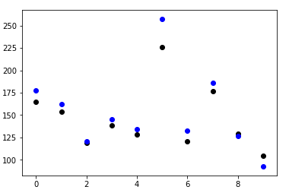
Linear Regression (Continued)
data_females_outliersdeleted_drop_BMI = data_females_outliersdeleted.drop(['BMI OVER 30'], axis = 1)
data_females_outliersdeleted_drop_BMI = data_females_outliersdeleted_drop_BMI[data_females_outliersdeleted_drop_BMI['LEG_LENGTH'] > 0]
data_females_outliersdeleted_drop_BMI = data_females_outliersdeleted_drop_BMI[data_females_outliersdeleted_drop_BMI['WAIST_CIRCUMFERENCE'] > 0]
data_females_outliersdeleted_drop_BMI = data_females_outliersdeleted_drop_BMI[data_females_outliersdeleted_drop_BMI['THIGH_CIRCUMFERENCE'] > 0]
## Creating training dataset
data_females_outliersdeleted_train_X = data_females_outliersdeleted_drop_BMI[:-10]
data_females_outliersdeleted_train_X = data_females_outliersdeleted_train_X.drop(['WEIGHT'], axis = 1)
data_females_outliersdeleted_train_Y = data_females_outliersdeleted_drop_BMI['WEIGHT'][:-10]
## Creating test dataset
data_females_outliersdeleted_test_X = data_females_outliersdeleted_drop_BMI[-10:]
data_females_outliersdeleted_test_X = data_females_outliersdeleted_test_X.drop(['WEIGHT'], axis = 1)
data_females_outliersdeleted_test_Y = data_females_outliersdeleted_drop_BMI['WEIGHT'][-10:]
## Create linear regression object
regr = linear_model.LinearRegression()
## Train the model using the training sets
regr.fit(data_females_outliersdeleted_train_X, data_females_outliersdeleted_train_Y)
## Make predictions using the testing set
data_females_WEIGHT_predicted = regr.predict(data_females_outliersdeleted_test_X)
## Making plots of actual weights and predicted weights
plt.scatter(np.arange(len(data_females_WEIGHT_predicted)), data_females_outliersdeleted_test_Y, color = 'k')
plt.scatter(np.arange(len(data_females_WEIGHT_predicted)), data_females_WEIGHT_predicted, color = 'b')
plt.show()
Actual Weight
Predicted Weight

Slide 18
How good is the Linear fit ?
print("Root Mean squared error: %.2f"
% np.sqrt(mean_squared_error(data_females_outliersdeleted_test_Y, data_females_WEIGHT_predicted)))
Root Mean squared error: 12.81
Actual Weight
Predicted Weight
How to determine importance of different features ?
Import sklearn
sklearn.feature_selection.f_regression(data_females_outliersdeleted_train_X, data_females_outliersdeleted_train_Y, center=True)
array([ nan, 1.73685091e-01, 1.07847714e-02,
nan, 2.67575867e-01, 2.00487357e-19,
4.27671504e-15]))
[GENDER, AGE, HEIGHT, MORE THAN SIXFOOT, LEG_LENGTH, WAIST CIRCUMFERNCE, THIGH_CIRCUMFERENCE]
[WAIST_CIRCUMFERENCE, THIGH_CIRCUMFERENCE, HEIGHT, AGE, LEG_LENGTH]
Most to least significant features

Slide 19
Logistic Regression
Logistic Regression is used to predict the outcome variables which take values only 0 or 1.
Avoid using Linear Regression when you are predicting outcome variables which take categorical values.
For example in this exercise the variable: BMI OVER 30 is a categorical variable and to predict for individuals if their BMI will be over 30 or not we need to use Logistic Regression.

Slide 20

Logistic Regression (Continued)
Can we determine for males whether BMI OVER 30 is 1 or 0 for individuals taking all the remaining variables as input variables ?
from sklearn.model_selection import train_test_split
from sklearn.linear_model import LogisticRegression
data_male_deletedOutliers_Y = data_male_deletedOutliers['BMI OVER 30']
data_male_deletedOutliers_X = data_male_deletedOutliers.drop(['BMI OVER 30'], axis = 1)
## Creating training/testing dataset
X_train, X_test, y_train, y_test = train_test_split(data_male_deletedOutliers_X, data_male_deletedOutliers_Y, test_size=0.3, random_state=42)
## Create linear regression object
logisticRegr = LogisticRegression()
## Train the model using the training sets
logisticRegr.fit(X_train, y_train)
## Make predictions using the testing set
BMI_OVER_30_PREDICTED_FOR_MALES = logisticRegr.predict(X_test)
## Printing Actual BMI OVER 30 and predictied
print("Actual BMI OVER 30 or not:")
print(np.asarray(y_test))
print("Predicted BMI OVER 30 or not:")
print(np.asarray(BMI_OVER_30_PREDICTED_FOR_MALES))

Slide 21

Logistic Regression (Continued)
How accurate was the prediction ?
from sklearn import metrics
metrics.roc_auc_score(y_test, BMI_OVER_30_PREDICTED_FOR_MALES)
1.0
The closer the value is to 1 for ROC_AUC score, the better the prediction quality is.
What are the most important features for prediction BMI over 30 ?
import sklearn
sklearn.feature_selection.f_regression(X_train,y_train, center=True)
[GENDER, AGE, WEIGHT, HEIGHT, MORE THAN SIXFOOT, LEG_LENGTH, WAIST CIRCUMFERNCE, THIGH_CIRCUMFERENCE]
Most to least significant features
[WEIGHT, WAIST CIRCUMFERNCE, THIGH_CIRCUMFERENCE, LEG_LENGTH, MORE THAN SIXFOOT, AGE, HEIGHT]

Slide 22
LASSO Regression
In statistics and machine learning, lasso (least absolute shrinkage and selection operator) (also Lasso or LASSO) is a regression analysis method that performs both variable selection and regularization in order to enhance the prediction accuracy and interpretability of the statistical model it produces.
LASSO Regression leverages Elastic Nets to produce accurate predictions.
Unlike Logistic Regression, LASSO can be used on any form of outcome variable.

Slide 23

LASSO Regression (Continued)
Can we predict BMI OVER 30 for females using LASSO Regression models ?
data_females_outliersdeleted = data_females_outliersdeleted[data_females_outliersdeleted['LEG_LENGTH'] > 0]
data_females_outliersdeleted = data_females_outliersdeleted[data_females_outliersdeleted['WAIST_CIRCUMFERENCE'] > 0]
data_females_outliersdeleted = data_females_outliersdeleted[data_females_outliersdeleted['THIGH_CIRCUMFERENCE'] > 0]
from sklearn.model_selection import train_test_split
from sklearn.linear_model import Lasso
data_females_outliersdeleted_Y = data_females_outliersdeleted['BMI OVER 30']
data_females_outliersdeleted_X = data_females_outliersdeleted.drop(['BMI OVER 30'], axis = 1)
## Creating training/testing dataset
X_train, X_test, y_train, y_test = train_test_split(data_females_outliersdeleted_X, data_females_outliersdeleted_Y, test_size=0.3, random_state=42)
## Create linear regression object
lassoRegr = Lasso(alpha=1e-03,normalize=True, max_iter=1e5)
## Train the model using the training sets
lassoRegr.fit(X_train, y_train)
## Make predictions using the testing set
BMI_OVER_30_PREDICTED_FOR_FEMALES = lassoRegr.predict(X_test)
## Printing Actual BMI OVER 30 and predictied
print("Actual BMI OVER 30 or not:")
print(np.asarray(y_test))
print("Predicted BMI OVER 30 or not:")
print(np.asarray(BMI_OVER_30_PREDICTED_FOR_FEMALES))
Definitely, this is not the result what we wanted. So, how do we refine the result ?
Looks like 0.5 might be a good threshold (i.e. any value more than 0.5 classify it as 1 and any value less than 0.5 classify it as 0)

Slide 24

Refined LASSO With threshold
data_females_outliersdeleted = data_females_outliersdeleted[data_females_outliersdeleted['LEG_LENGTH'] > 0]
data_females_outliersdeleted = data_females_outliersdeleted[data_females_outliersdeleted['WAIST_CIRCUMFERENCE'] > 0]
data_females_outliersdeleted = data_females_outliersdeleted[data_females_outliersdeleted['THIGH_CIRCUMFERENCE'] > 0]
from sklearn.model_selection import train_test_split
from sklearn.linear_model import Lasso
data_females_outliersdeleted_Y = data_females_outliersdeleted['BMI OVER 30']
data_females_outliersdeleted_X = data_females_outliersdeleted.drop(['BMI OVER 30'], axis = 1)
## Creating training/testing dataset
X_train, X_test, y_train, y_test = train_test_split(data_females_outliersdeleted_X, data_females_outliersdeleted_Y, test_size=0.3, random_state=42)
## Create linear regression object
lassoRegr = Lasso(alpha=1e-03,normalize=True, max_iter=1e5)
## Train the model using the training sets
lassoRegr.fit(X_train, y_train)
## Make predictions using the testing set
BMI_OVER_30_PREDICTED_FOR_FEMALES = lassoRegr.predict(X_test)
## Making the predictions with threshold
BMI_OVER_30_PREDICTED_FOR_FEMALES_WITH_THRESHOLD = []
count = 0
while (count < len(BMI_OVER_30_PREDICTED_FOR_FEMALES)):
if (BMI_OVER_30_PREDICTED_FOR_FEMALES[count] >= 0.5):
BMI_OVER_30_PREDICTED_FOR_FEMALES_WITH_THRESHOLD.append(1)
else:
BMI_OVER_30_PREDICTED_FOR_FEMALES_WITH_THRESHOLD.append(0)
count = count + 1
## Printing Actual BMI OVER 30 and predictied
print("Actual BMI OVER 30 or not:")
print(np.asarray(y_test))
print("Predicted BMI OVER 30 or not after thresholding:")
print(np.asarray(BMI_OVER_30_PREDICTED_FOR_FEMALES_WITH_THRESHOLD))

Slide 25

LASSO Regression (Continued)
How accurate was the prediction ?
from sklearn import metrics
metrics.roc_auc_score(y_test, BMI_OVER_30_PREDICTED_FOR_FEMALES_WITH_THRESHOLD)
0.944
The closer the value is to 1 for ROC_AUC score, the better the prediction quality is.
print("Root Mean squared error: %.2f"
% np.sqrt(mean_squared_error(y_test, BMI_OVER_30_PREDICTED_FOR_FEMALES_WITH_THRESHOLD)))
0.26
The closer the value is to 0 for RMSE, the better the prediction quality is.
What are the most important features for prediction BMI over 30 ?
import sklearn
sklearn.feature_selection.f_regression(X_train,y_train, center=True)
[GENDER, AGE, WEIGHT, HEIGHT, MORE THAN SIXFOOT, LEG_LENGTH, WAIST CIRCUMFERNCE, THIGH_CIRCUMFERENCE]
Most to least significant features
[WEIGHT, THIGH_CIRCUMFERNCE, WAIST_CIRCUMFERENCE, AGE, HEIGHT, LEG_LENGTH]

Slide 26
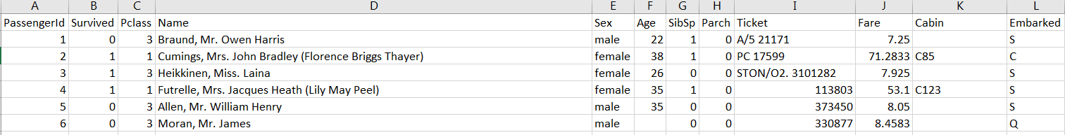
Example 2: Titanic Data
Click on the following dataset and save it with the name Titanic.xlsx in the folder DataSet
Snapshot of the dataset:
PassengerId is the Id of the Passengers.
Survived or not.
Pclass is the boarding class. [1st = Upper, 2nd = Middle, 3rd = Lower]
Name is the name of the passenger.
Sex is male or female.
Age is the age of the passenger.
SibSp is the number of siblings or spouses boarded the Titanic.
Parch is the number of parents or children boarded the Titanic.
Ticket is the ticket number
Fare is the passenger fare in pounds
Cabin is the cabin number if available.
Embarked is the port of embarkation. [C = Cherbourg, Q = Queenstown, S = Southampton]

Slide 27
Can we predict the survivors ?
For the Titanic data we will split the data into training and testing datasets
A model will be trained on the training data.
The goal is to predict whether an individual would be a survivor or not in the test.
To do this analysis we will follow the following steps:
  Clean up the data for analysis
  Define dummy variables whenever necessary
  Do some exploratory analysis on the data.
  Train Logistic models on the training data.
  Make predictions on chance of survival of the individuals.

Slide 28
Cleaning up data and creating dummy variables
Data Cleanup:
import numpy as np
import pandas as pd
data_titanic = pd.read_excel("C:/Users/IBM_ADMIN/Desktop/DataSet/Titanic.xlsx")
data_titanic = data_titanic.drop(['Cabin', 'Ticket', 'Name', 'PassengerId'], axis = 1)
data_titanic = data_titanic.dropna(subset = ['Embarked']) # Dropping NA values from Embarked
data_titanic = data_titanic.fillna(np.int(np.mean(data_titanic['Age']))) #Filling NA values of age by its mean value
Creating dummy variables for categorical variables:
data_titanic = data_titanic.reset_index(drop=True)
### Dochomatizing Sex
sLength = len(data_titanic['Sex'])
data_titanic['Male_Indicator'] = pd.Series(np.random.randn(sLength), index=data_titanic.index)
count = 0
while (count < sLength):
if (data_titanic['Sex'][count] == 'male'):
data_titanic['Male_Indicator'][count] = 1
else:
data_titanic['Male_Indicator'][count] = 0
count = count + 1
sLength = len(data_titanic['Sex'])
data_titanic['Female_Indicator'] = pd.Series(np.random.randn(sLength), index=data_titanic.index)
count = 0
while (count < sLength):
if (data_titanic['Sex'][count] == 'female'):
data_titanic['Female_Indicator'][count] = 1
else:
data_titanic['Female_Indicator'][count] = 0
count = count + 1

Slide 29
Cleaning up data and creating dummy variables (Continued)
Creating dummy variables for categorical variables:
### Dochomatizing Pclass
sLength = len(data_titanic['Pclass'])
data_titanic['Class_1'] = pd.Series(np.random.randn(sLength), index=data_titanic.index)
count = 0
while (count < sLength):
if (data_titanic['Pclass'][count] == 1):
data_titanic['Class_1'][count] = 1
else:
data_titanic['Class_1'][count] = 0
count = count + 1
sLength = len(data_titanic['Pclass'])
data_titanic['Class_2'] = pd.Series(np.random.randn(sLength), index=data_titanic.index)
count = 0
while (count < sLength):
if (data_titanic['Pclass'][count] == 2):
data_titanic['Class_2'][count] = 1
else:
data_titanic['Class_2'][count] = 0
count = count + 1
sLength = len(data_titanic['Pclass'])
data_titanic['Class_3'] = pd.Series(np.random.randn(sLength), index=data_titanic.index)
count = 0
while (count < sLength):
if (data_titanic['Pclass'][count] == 3):
data_titanic['Class_3'][count] = 1
else:
data_titanic['Class_3'][count] = 0
count = count + 1

Slide 30
Cleaning up data and creating dummy variables (Continued)
Creating dummy variables for categorical variables:
### Dochomatizing Embarkment
sLength = len(data_titanic['Embarked'])
data_titanic['Place_S'] = pd.Series(np.random.randn(sLength), index=data_titanic.index)
count = 0
while (count < sLength):
if (data_titanic['Embarked'][count] == 'S'):
data_titanic['Place_S'][count] = 1
else:
data_titanic['Place_S'][count] = 0
count = count + 1
sLength = len(data_titanic['Embarked'])
data_titanic['Place_C'] = pd.Series(np.random.randn(sLength), index=data_titanic.index)
count = 0
while (count < sLength):
if (data_titanic['Embarked'][count] == 'C'):
data_titanic['Place_C'][count] = 1
else:
data_titanic['Place_C'][count] = 0
count = count + 1
sLength = len(data_titanic['Embarked'])
data_titanic['Place_Q'] = pd.Series(np.random.randn(sLength), index=data_titanic.index)
count = 0
while (count < sLength):
if (data_titanic['Embarked'][count] == 'Q'):
data_titanic['Place_Q'][count] = 1
else:
data_titanic['Place_Q'][count] = 0
count = count + 1

Slide 31
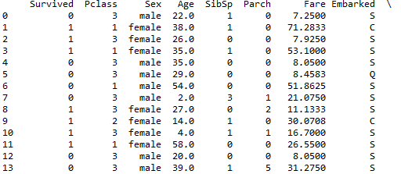
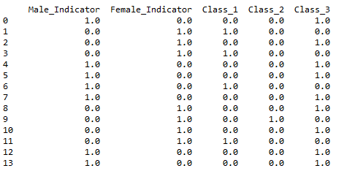
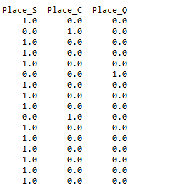
How does the data look like now
data_titanic

Slide 32
Dropping variables Sex, Pclass and Embarked
### Dropping Sex from data
data_titanic = data_titanic.drop(['Sex'], axis = 1)
### Dropping Pclass from data
data_titanic = data_titanic.drop(['Pclass'], axis = 1)
### Dropping Embarked from data
data_titanic = data_titanic.drop(['Embarked'], axis = 1)

Slide 33
Splitting data into training and testing set
from sklearn.model_selection import train_test_split
from sklearn.linear_model import Lasso
data_titanic_Y = data_titanic['Survived']
data_titanic_X = data_titanic.drop(['Survived'], axis = 1)
## Creating training/testing dataset
X_train, X_test, y_train, y_test = train_test_split(data_titanic_X, data_titanic_Y, test_size=0.25, random_state=42)
How do the training data and test data look like after splitting ?

Slide 34
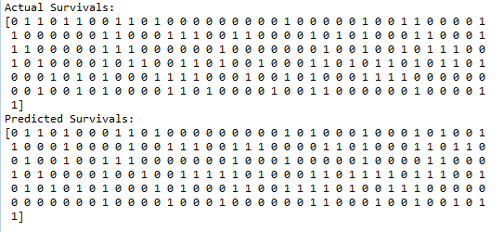
Logistic regression for Predicting Survival
## Create linear regression object
logisticRegr = LogisticRegression()
## Train the model using the training sets
logisticRegr.fit(X_train, y_train)
## Make predictions using the testing set
PREDICTED_SURVIVAL = logisticRegr.predict(X_test)
## Printing Actual BMI OVER 30 and predictied
print("Actual Survivals:")
print(np.asarray(y_test))
print("Predicted Survivals:")
print(np.asarray(PREDICTED_SURVIVAL))

Slide 35


Accuracy of Prediction
from sklearn import metrics
metrics.roc_auc_score(y_test, PREDICTED_SURVIVAL)
We have done a decent prediction.
We will also calculate average number of misclassifications.
print("Average Number of Misscalssification: %.2f"
% mean_squared_error(y_test,PREDICTED_SURVIVAL))
We have made roughly 21% misclassifications.
Hence our model has an accuracy of 79% which is decent enough
This data was very volatile and hence predictions are off in some cases
Also for this example let us look at what are the most influential variables:
import sklearn
sklearn.feature_selection.f_regression(X_train,y_train, center=True)
[Male, Female, Class_3, Class_1, Fare, Place_C, Place_S, Class_2]

Slide 36
Machine Learning Techniques
Classification Techniques

Slide 37
What are Classification Problems ?
Classification problems arise when the outcome variable is needed to be classified into different groups based on the input variables. If the outcome variable is categorical, for predicting the outcome variable we can use classification techniques.
For example, the prediction of survival in the context of titanic data is in fact a classification problem.
In the next few slides we will cover different classification techniques which are very popular in Machine Learning domain.

Slide 38
k -Nearest Neighbor
In machine learning, the k-nearest neighbors algorithm (k-NN) is a non-parametric method used for
classification and regression.
In both cases, the input consists of the k closest training examples in the feature space. The output depends on whether k-NN is used for classification or regression:
      In k-NN classification, the output is a class membership. An object is classified by a majority
      vote of its neighbors, with the object being assigned to the class most common among its
      k nearest neighbors (k is a positive integer, typically small). If k = 1, then the object is simply
      assigned to the class of that single nearest neighbor.
      In k-NN regression, the output is the property value for the object. This value is the average of
      the values of its k nearest neighbors.
k-NN is a type of instance-based learning, or lazy learning, where the function is only approximated locally and all computation is deferred until classification. The k-NN algorithm is among the simplest of all
machine learning algorithms.

Slide 39
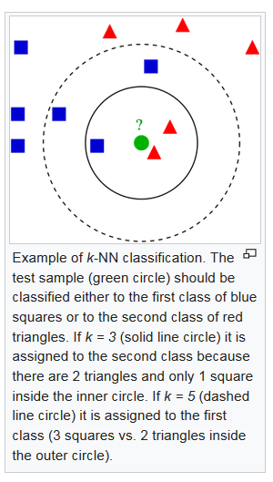
k-Nearest Neighbor (continued)

Slide 40
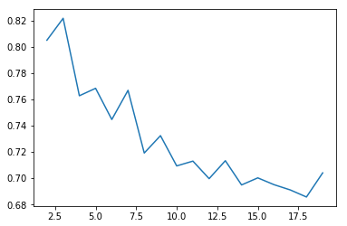
k-nearest neighbor classification on Titanic Data
import numpy as np
import matplotlib.pyplot as plt
from sklearn import neighbors
from sklearn.model_selection import train_test_split
data_titanic_Y = data_titanic['Survived']
data_titanic_X = data_titanic.drop(['Survived'], axis = 1)
## Creating training/testing dataset
X_train, X_test, y_train, y_test = train_test_split(data_titanic_X, data_titanic_Y, test_size=0.25, random_state=42)
ROC_AUC = []
for weights in ['uniform']:
# we create an instance of Neighbours Classifier and fit the data.
for n_neighbors in np.arange(2,20):
#print(n_neighbors)
clf = neighbors.KNeighborsClassifier(n_neighbors, weights=weights)
clf.fit(X_train, y_train)
PREDICTED_SURVIVAL_TRAIN = clf.predict(X_train)
from sklearn import metrics
ROC_AUC.append(metrics.roc_auc_score(y_train, PREDICTED_SURVIVAL_TRAIN))
plt.plot(np.arange(2,20), ROC_AUC)
plt.show()
ROC_AUC_score
n_neighbors
From the plot it seems 3 is the optimal number for n_neighbors

Slide 41
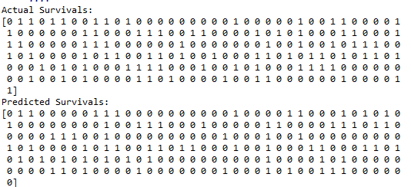
k-nearest neighbor classification on Titanic Data (n_neighbors = 3)
import numpy as np
import matplotlib.pyplot as plt
from sklearn import neighbors
from sklearn.model_selection import train_test_split
data_titanic_Y = data_titanic['Survived']
data_titanic_X = data_titanic.drop(['Survived'], axis = 1)
## Creating training/testing dataset
X_train, X_test, y_train, y_test = train_test_split(data_titanic_X, data_titanic_Y, test_size=0.25, random_state=42)
n_neighbors = 3
for weights in ['uniform']:
# we create an instance of Neighbours Classifier and fit the data.
clf = neighbors.KNeighborsClassifier(n_neighbors, weights=weights)
clf.fit(X_train, y_train)
PREDICTED_SURVIVAL_TEST = clf.predict(X_test)
print("Actual Survivals:")
print(np.asarray(y_test))
print("Predicted Survivals:")
print(np.asarray(PREDICTED_SURVIVAL_TEST))
from sklearn import metrics
metrics.roc_auc_score(y_test, PREDICTED_SURVIVAL_TEST)
ROC_AUC_Score = 0.686732

Slide 42
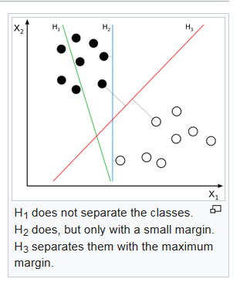
Support Vector Machine (SVM)
In machine learning, support vector machines (SVMs, also support vector networks) are supervised learning models with associated learning algorithms that analyze data used for classification and regression analysis. Given a set of training examples, each marked as belonging to one or the other of two categories, an SVM training algorithm builds a model that assigns new examples to one category or the other, making it a non-probabilistic binary linear classifier (although methods such as Platt scaling exist to use SVM in a probabilistic classification setting).

Slide 43
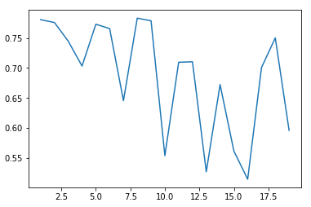
SVM classification on Titanic Data
from sklearn import svm
import matplotlib.pyplot as plt
from sklearn import neighbors
from sklearn.model_selection import train_test_split
data_titanic_Y = data_titanic['Survived']
data_titanic_X = data_titanic.drop(['Survived'], axis = 1)
## Creating training/testing dataset
X_train, X_test, y_train, y_test = train_test_split(data_titanic_X, data_titanic_Y, test_size=0.25, random_state=42)
ROC_AUC = []
for error_term in np.arange(1,20):
clf = svm.LinearSVC(C=error_term*0.25)
clf.fit(X_train, y_train)
PREDICTED_SURVIVAL_TRAIN = clf.predict(X_train)
from sklearn import metrics
ROC_AUC.append(metrics.roc_auc_score(y_train, PREDICTED_SURVIVAL_TRAIN))
plt.plot(np.arange(1,20), ROC_AUC)
plt.show()
ROC_AUC_score
From the plot it seems error_term 1.75 is the optimal penalty term.
error_term/0.25

Slide 44
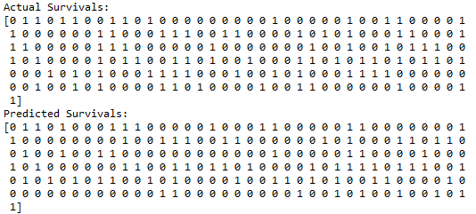
SVM classification on Titanic Data (penalty = 1.75)
from sklearn import svm
import matplotlib.pyplot as plt
from sklearn import neighbors
from sklearn.model_selection import train_test_split
data_titanic_Y = data_titanic['Survived']
data_titanic_X = data_titanic.drop(['Survived'], axis = 1)
## Creating training/testing dataset
X_train, X_test, y_train, y_test = train_test_split(data_titanic_X, data_titanic_Y, test_size=0.25, random_state=42)
clf = svm.LinearSVC(C=1.75)
clf.fit(X_train, y_train)
PREDICTED_SURVIVAL_TEST = clf.predict(X_test)
print("Actual Survivals:")
print(np.asarray(y_test))
print("Predicted Survivals:")
print(np.asarray(PREDICTED_SURVIVAL_TEST))
from sklearn import metrics
metrics.roc_auc_score(y_test, PREDICTED_SURVIVAL_TEST)
ROC_AUC_Score = 0.7451

Slide 45
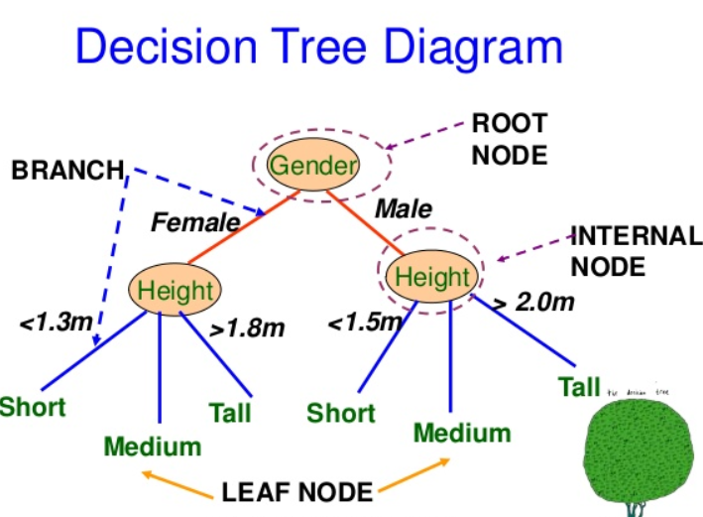
Decision Tree
A decision tree is a decision support tool that uses a tree-like graph or model of decisions and their possible consequences, including chance event outcomes, resource costs, and utility. It is one way to display an algorithm that only contains conditional control statements.
Decision trees are commonly used in operations research, specifically in decision analysis, to help identify a strategy most likely to reach a goal, but are also a popular tool in machine learning.

Slide 46
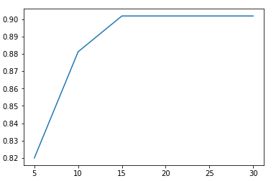
Decision Tree Classification on Titanic Data
from sklearn import tree
import matplotlib.pyplot as plt
from sklearn.model_selection import train_test_split
data_titanic_Y = data_titanic['Survived']
data_titanic_X = data_titanic.drop(['Survived'], axis = 1)
## Creating training/testing dataset
X_train, X_test, y_train, y_test = train_test_split(data_titanic_X, data_titanic_Y, test_size=0.25, random_state=42)
ROC_AUC = []
for maxdepth in [5, 10, 15, 20, 25, 30]:
clf = tree.DecisionTreeClassifier(max_depth = maxdepth, min_samples_leaf = 2, min_samples_split=2)
clf.fit(X_train, y_train)
PREDICTED_SURVIVAL_TRAIN = clf.predict(X_train)
from sklearn import metrics
ROC_AUC.append(metrics.roc_auc_score(y_train, PREDICTED_SURVIVAL_TRAIN))
plt.plot(np.array([5, 10, 15, 20, 25, 30]), ROC_AUC)
plt.show()
ROC_AUC_score
From the plot optimal max_depth seems to be 13
max_depth

Slide 47
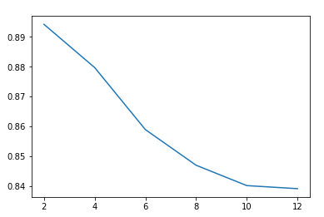
Decision Tree Classification on Titanic Data (max_depth = 13)
from sklearn import tree
import matplotlib.pyplot as plt
from sklearn.model_selection import train_test_split
data_titanic_Y = data_titanic['Survived']
data_titanic_X = data_titanic.drop(['Survived'], axis = 1)
## Creating training/testing dataset
X_train, X_test, y_train, y_test = train_test_split(data_titanic_X, data_titanic_Y, test_size=0.25, random_state=42)
ROC_AUC = []
for minsamplesleaf in [2, 4, 6, 8, 10, 12]:
clf = tree.DecisionTreeClassifier(max_depth = 13, min_samples_leaf = minsamplesleaf, min_samples_split=2)
clf.fit(X_train, y_train)
PREDICTED_SURVIVAL_TRAIN = clf.predict(X_train)
from sklearn import metrics
ROC_AUC.append(metrics.roc_auc_score(y_train, PREDICTED_SURVIVAL_TRAIN))
plt.plot(np.array([2, 4, 6, 8, 10, 12]), ROC_AUC)
plt.show()
ROC_AUC_score
From the plot the optimal min_samples_leaf seems to be 14.
min_samples_leaf

Slide 48
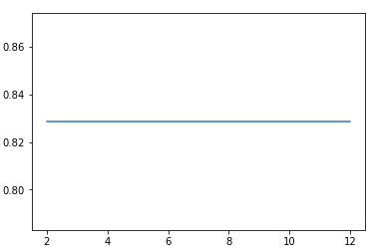
Decision Tree Classification on Titanic Data (max_depth = 13, min_samples_leaf=14)
from sklearn import tree
import matplotlib.pyplot as plt
from sklearn.model_selection import train_test_split
data_titanic_Y = data_titanic['Survived']
data_titanic_X = data_titanic.drop(['Survived'], axis = 1)
## Creating training/testing dataset
X_train, X_test, y_train, y_test = train_test_split(data_titanic_X, data_titanic_Y, test_size=0.25, random_state=42)
ROC_AUC = []
for minsamplessplit in [2, 4, 6, 8, 10, 12]:
clf = tree.DecisionTreeClassifier(max_depth = 13, min_samples_leaf = 14, min_samples_split=minsamplessplit)
clf.fit(X_train, y_train)
PREDICTED_SURVIVAL_TRAIN = clf.predict(X_train)
from sklearn import metrics
ROC_AUC.append(metrics.roc_auc_score(y_train, PREDICTED_SURVIVAL_TRAIN))
plt.plot(np.array([2, 4, 6, 8, 10, 12]), ROC_AUC)
plt.show()
ROC_AUC_score
From the plot the optimal min_samples_split seems to be 2.
min_samples_leaf

Slide 49
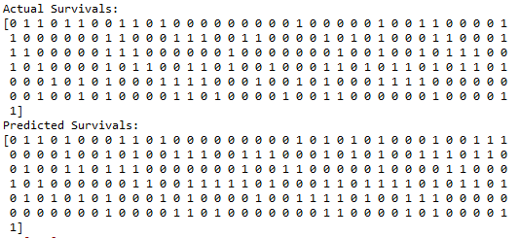
Decision Tree Classification on Titanic Data (max_depth = 13, min_samples_leaf=14, min_samples_split = 2)
from sklearn import tree
import matplotlib.pyplot as plt
from sklearn.model_selection import train_test_split
data_titanic_Y = data_titanic['Survived']
data_titanic_X = data_titanic.drop(['Survived'], axis = 1)
## Creating training/testing dataset
X_train, X_test, y_train, y_test = train_test_split(data_titanic_X, data_titanic_Y, test_size=0.25, random_state=42)
clf = tree.DecisionTreeClassifier(max_depth = 13, min_samples_leaf = 14, min_samples_split=2)
clf.fit(X_train, y_train)
PREDICTED_SURVIVAL_TEST = clf.predict(X_test)
print("Actual Survivals:")
print(np.asarray(y_test))
print("Predicted Survivals:")
print(np.asarray(PREDICTED_SURVIVAL_TEST))
from sklearn import metrics
metrics.roc_auc_score(y_test, PREDICTED_SURVIVAL_TEST)
ROC_AUC_Score = 0.8051

Slide 50
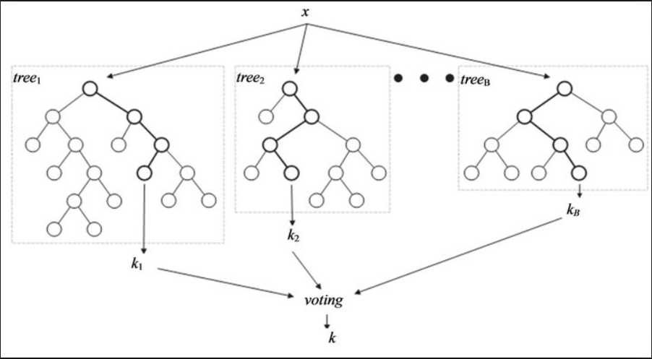
Random Forrest Classifier
Random forests or random decision forests are an ensemble learning method for classification, regression and other tasks, that operate by constructing a multitude of decision trees at training time and outputting the class that is the mode of the classes (classification) or mean prediction (regression) of the individual trees. Random decision forests correct for decision trees' habit of overfitting to their training set.

Slide 51
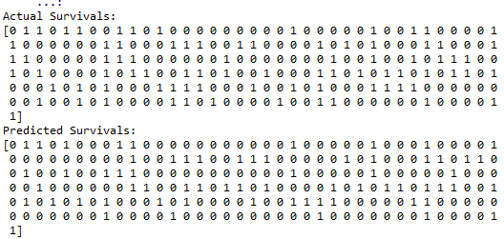
Random Forrest Classification on Titanic Data
from sklearn.ensemble import RandomForestClassifier
import matplotlib.pyplot as plt
from sklearn.model_selection import train_test_split
data_titanic_Y = data_titanic['Survived']
data_titanic_X = data_titanic.drop(['Survived'], axis = 1)
## Creating training/testing dataset
X_train, X_test, y_train, y_test = train_test_split(data_titanic_X, data_titanic_Y, test_size=0.25, random_state=42)
clf = RandomForestClassifier(max_depth = 13, min_samples_leaf = 14, min_samples_split=2)
clf.fit(X_train, y_train)
PREDICTED_SURVIVAL_TEST = clf.predict(X_test)
print("Actual Survivals:")
print(np.asarray(y_test))
print("Predicted Survivals:")
print(np.asarray(PREDICTED_SURVIVAL_TEST))
from sklearn import metrics
metrics.roc_auc_score(y_test, PREDICTED_SURVIVAL_TEST)
ROC_AUC_Score = 0.78061

